Slide 1
Westside High School
Oct 3-7 Week At a Glance
(WAG)

Slide 2
Coach Thomas
Weight Training: Oct 3-7

Slide 3
Monday - Agenda
Oct 3
Standard:
PEWT.4 The physically educated student exhibits responsible personal and social behavior
that respects self and others in physical activity settings.
a. Displays the ability to follow rules, procedures, and routines appropriate in the weight
training setting.
b. Exhibits the ability to demonstrate safe and responsible behavior.
c. Identifies the difference between encouraging and discouraging progression while
training.
d. Demonstrates the ability to apply the rules and etiquette of various weight training
activities
Learning Target
I can determine next steps for reaching SMART goals for the current semester utilizing data
Opening ( 10-15 mins)
5 minute Walk & Attendance
Work-session ( 20 - 25 mins)
Locker-room & Report to Stage
Fitness Assessments:
*Record: Resting HR, Max HR, BMI
_Max Out: bench press
_Cardio: 6 laps timed
_Burn Out: bicep curls (set weights 8-15lbs)
Criteria for Success
I can assess my current progress toward my SMART goal using data
Students recording data for tracking progress
Closing ( 05 – 10 mins)
Locker Room & cool down stretches

Slide 4
Tuesday - Agenda
Learning Target
Oct 4 Standard:
Same as previous day for lower body
PEWT.4 The physically educated student exhibits responsible personal and social behavior
that respects self and others in physical activity settings.
a. Displays the ability to follow rules, procedures, and routines appropriate in the weight
training setting.
b. Exhibits the ability to demonstrate safe and responsible behavior.
c. Identifies the difference between encouraging and discouraging progression while
training.
d. Demonstrates the ability to apply the rules and etiquette of various weight training
activities
Opening ( 10-15 mins)
10 minute Walk & Attendance
Work-session ( 20 - 25 mins)
Locker-room & Report to Stage
Fitness Assessments:
_Max Out: Leg Press
_Core: crunches & oblique twist
_Burn Out: Leg Ext (set weights 10-25lbs)
Criteria for Success
Same as previous day for lower body & core
Closing ( 05 – 10 mins)
Cool down stretches

Slide 5
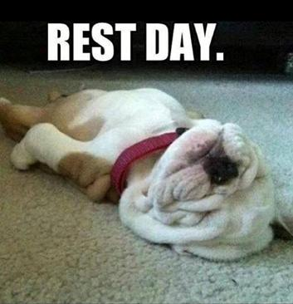
Wednesday - Agenda
Learning Target
Oct 5 Standard:
Opening ( 10-15 mins)
5 minute Walk
Work-session ( 20 - 25 mins)
Criteria for Success
Closing ( 05 – 10 mins)
-locker room unlocked for 5 minutes

Slide 6
Thursday - Agenda
Sept 29 Standard:
PEWT.4 The physically educated student exhibits responsible personal and social behavior
that respects self and others in physical activity settings.
a. Displays the ability to follow rules, procedures, and routines appropriate in the weight
training setting.
b. Exhibits the ability to demonstrate safe and responsible behavior.
c. Identifies the difference between encouraging and discouraging progression while
training.
d. Demonstrates the ability to apply the rules and etiquette of various weight training
activities
Learning Target
Opening ( 10-15 mins)
Work-session ( 20 - 25 mins)
Criteria for Success
Closing ( 05 – 10 mins)

Slide 7
Friday - Agenda
Learning Target
Sept 30 Standard:
PEWT.4 The physically educated student exhibits responsible personal and social behavior
that respects self and others in physical activity settings.
a. Displays the ability to follow rules, procedures, and routines appropriate in the weight
training setting.
b. Exhibits the ability to demonstrate safe and responsible behavior.
c. Identifies the difference between encouraging and discouraging progression while
training.
d. Demonstrates the ability to apply the rules and etiquette of various weight training
activities
Asynchronous Learning
Opening ( 10-15 mins)
Attendance
Work-session ( 20 - 25 mins)
Asynchronous
Get Out the House & Be Active
Ideas
Tennis
Run around neighborhood
Basketball
2 Hand Touch Football
Ride Bike
Criteria for Success
n/a
Closing ( 05 – 10 mins)
N/A

Slide 8
Resources
https://www.nike.com/nrc-app
https://www.rcboe.org/westside

